Slide 1

The Silent Profit Margin Killer
Ryan Cooley and Owen Nelson

Slide 2



Goals Today
Why are we here?
Establish context within the Global Superstore dataset.
What have we found?
Examine insights and explain the meanings of those insights.
How will we solve it?
Drive the decision.

Slide 3
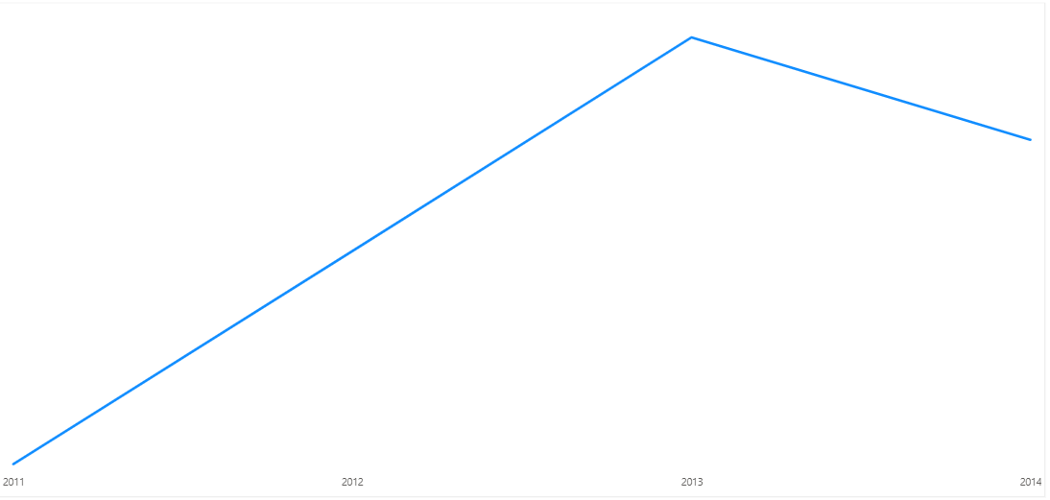
Overall Profit Margin Declined from 2013 - 2014

Slide 4
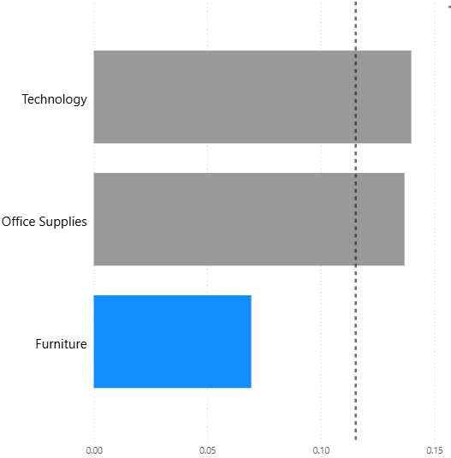
Furniture has below-average profit margins
Notes:
At 7%

Slide 5
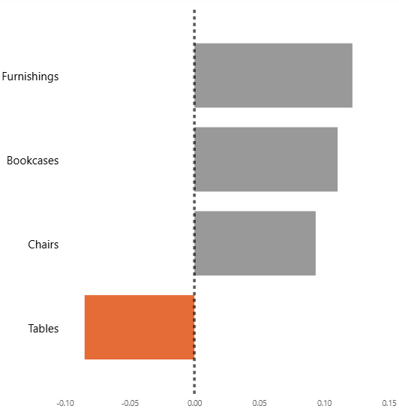
Tables have negative profit margins
Notes:
At –7%

Slide 6
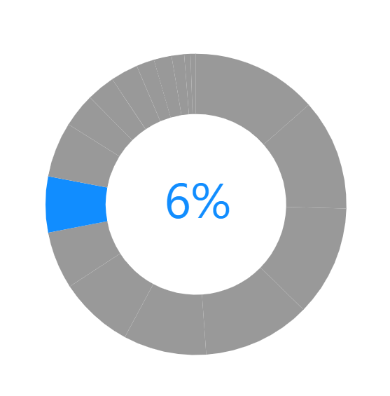
Tables: Ranked 8th in Total Sales
Notes:
8th total sold item in the company sale price wise at 757k

Slide 7
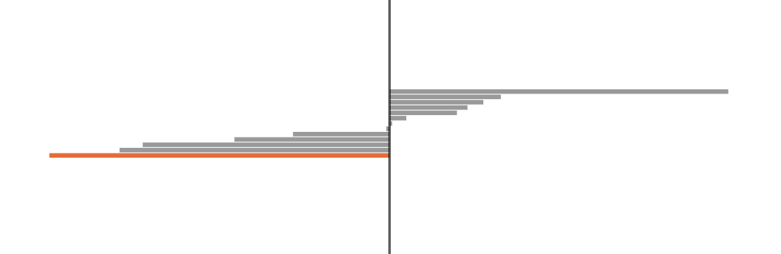

Table sales in Southeast Asia generate the lowest profit
With – 35% profit margin on each sale
Notes:
Southeast Asia has the worst profit margin of all regions on table sales with the east and south at –0.28 and –0.26 respectfully.

Slide 8
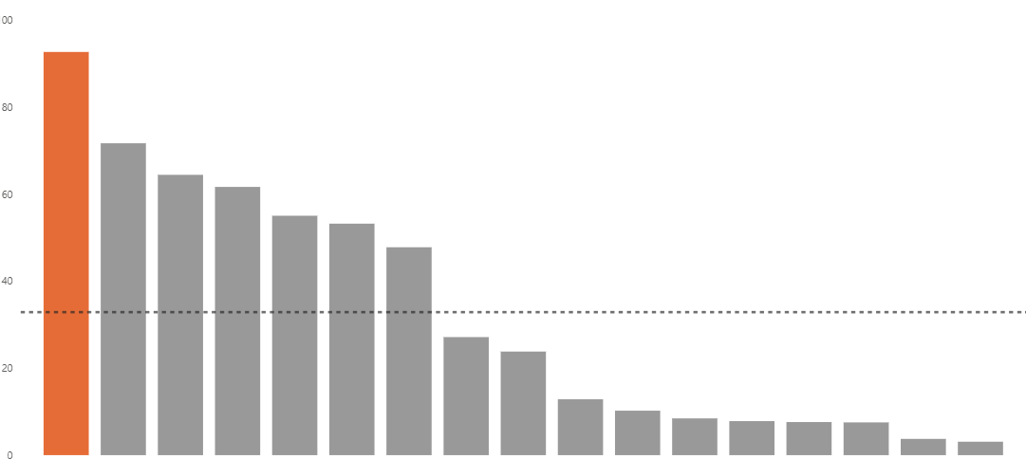
Tables have the highest shipping cost
Notes:
Tables average $92.75 just in shipping costs where as the next expensive are copiers at 71.75. Meaning shipping tables are 30% more expensive than copiers

Slide 9
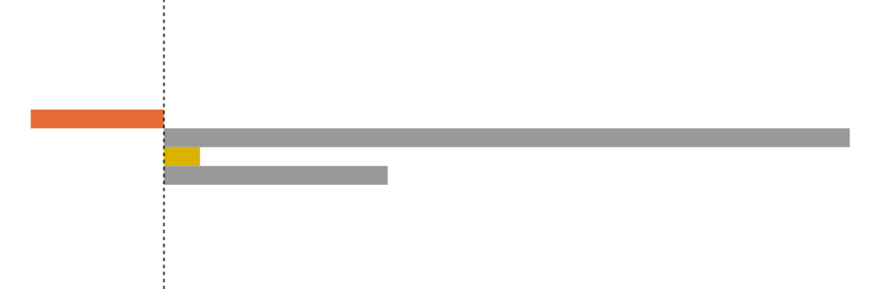
First-Class Shipping Causes Losses; Second-Class Breaks Even
Notes:
First class shipping has –2% profit margin, Second Class has 0%, Standard is 3% and Same Day is 9%

Slide 10

1/3 of all Southeast Asia sales are unprofitable
Notes:
15.62% of sales use First Class Shipping while 16.93 use Second Class meaning a combined 32% of sales in Southeast Asia Are unprofitable

Slide 11

Solution?
Charge a premium?
Apply premium to First-Class and Second-Class to ensure profit.
Cut program?
No longer offer First-Class and Second-Class Shipping
Conduct further analysis?
Spend more time and resources towards finding a different solution.
Do nothing?
Continue business as is and watch profits decrease.

Slide 12
Questions?

